Slide 1
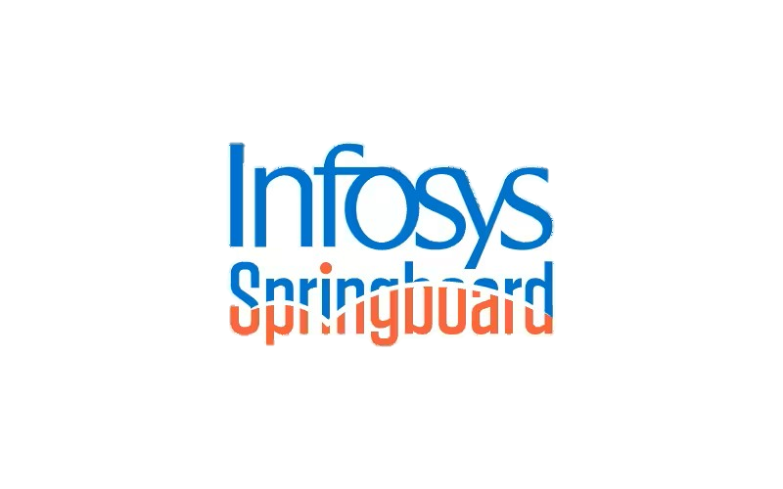
AI Powered Regulatory Compliance Checker for Contracts
UNDER THE GUIDANCE PRESENTED BY:
Mr. Aman Kumar Joseph Kumar Thumma

Slide 2
TABLE OF CONTENTS:
  INTRODUCTION
  PROBLEM STATEMENT
  OBJECTIVES
  ARCHITECTURE
  TECHNOLOGY STACK
  FEATURES
  FUTURE IMPROVEMENTS
  CONCLUSION

Slide 3
INTRODUCTION:
Contracts must comply with multiple regulations like GDPR, HIPAA, and industry standards.
Manual contract review is time-consuming, costly, and prone to human error.
Regulatory updates happen frequently, increasing the risk of non-compliance.
AI and LLMs enable automated analysis of large, unstructured contract documents.
This project develops an AI-powered system that reviews contracts, detects compliance gaps, and suggests corrections.
A RAG (Retrieval-Augmented Generation) pipeline ensures accurate, context-aware compliance checking.

Slide 4
PROBLEM STATEMENT:
Organizations manage a large number of legal contracts across different domains
Regulatory standards such as GDPR and HIPAA frequently change
Manual contract compliance review is time-consuming and error-prone
Important clauses may be missing, outdated, or non-compliant
There is no automated system to track changes, assess risks, and notify stakeholders in real time
This increases legal risks, compliance violations, and operational costs.

Slide 5
OBJECTIVES:
To develop an AI-powered system for automated contract compliance analysis
To detect missing, outdated, or risky clauses in legal contracts
To ensure compliance with regulations such as GDPR and HIPAA
To implement Retrieval-Augmented Generation (RAG) for accurate legal analysis
To track contract updates and version changes automatically
To generate compliance reports and amendment suggestions
To provide real-time notifications and alerts through integrated platforms

Slide 6
ARCHITECTURE:
System Architecture:
The system integrates multiple data sources: contract documents, Google Sheets, emails,
and regulatory websites.
Text is extracted and cleaned, then split into manageable chunks for semantic processing.
Each chunk is converted to numerical embeddings using a Transformer-based model.
Embeddings are stored in a vector database (FAISS) for efficient semantic search.
A retrieval engine fetches relevant context for a given query using semantic similarity
LLM & Compliance Engine Architecture:
The retrieved text chunks are provided to a Large Language Model (Groq LLaMA-3.3)
via LangChain.

Slide 7
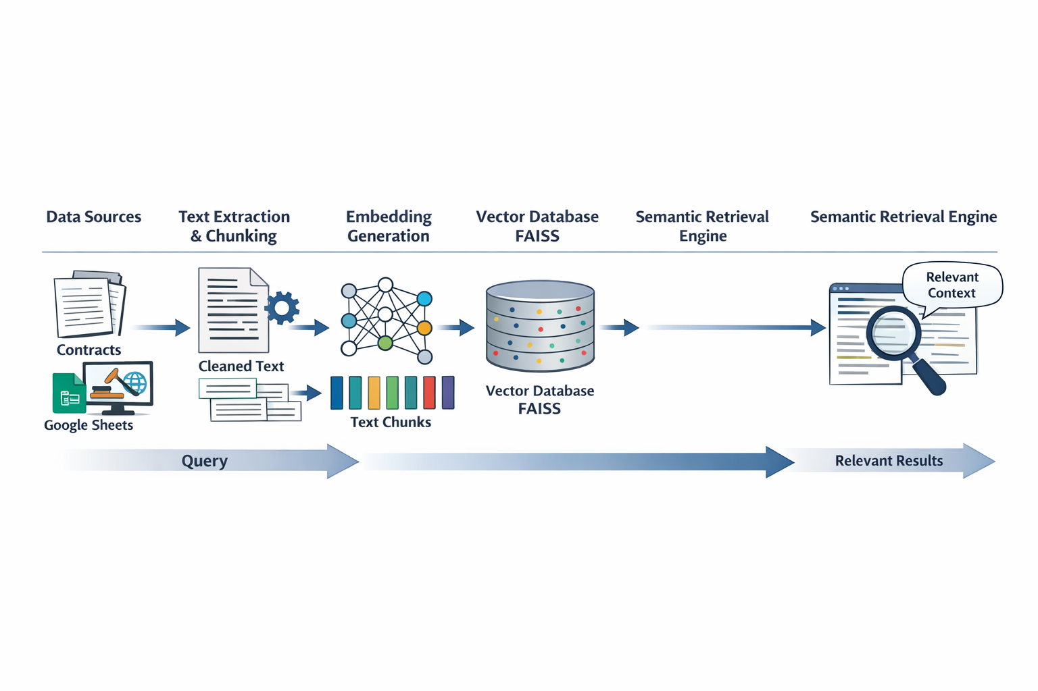
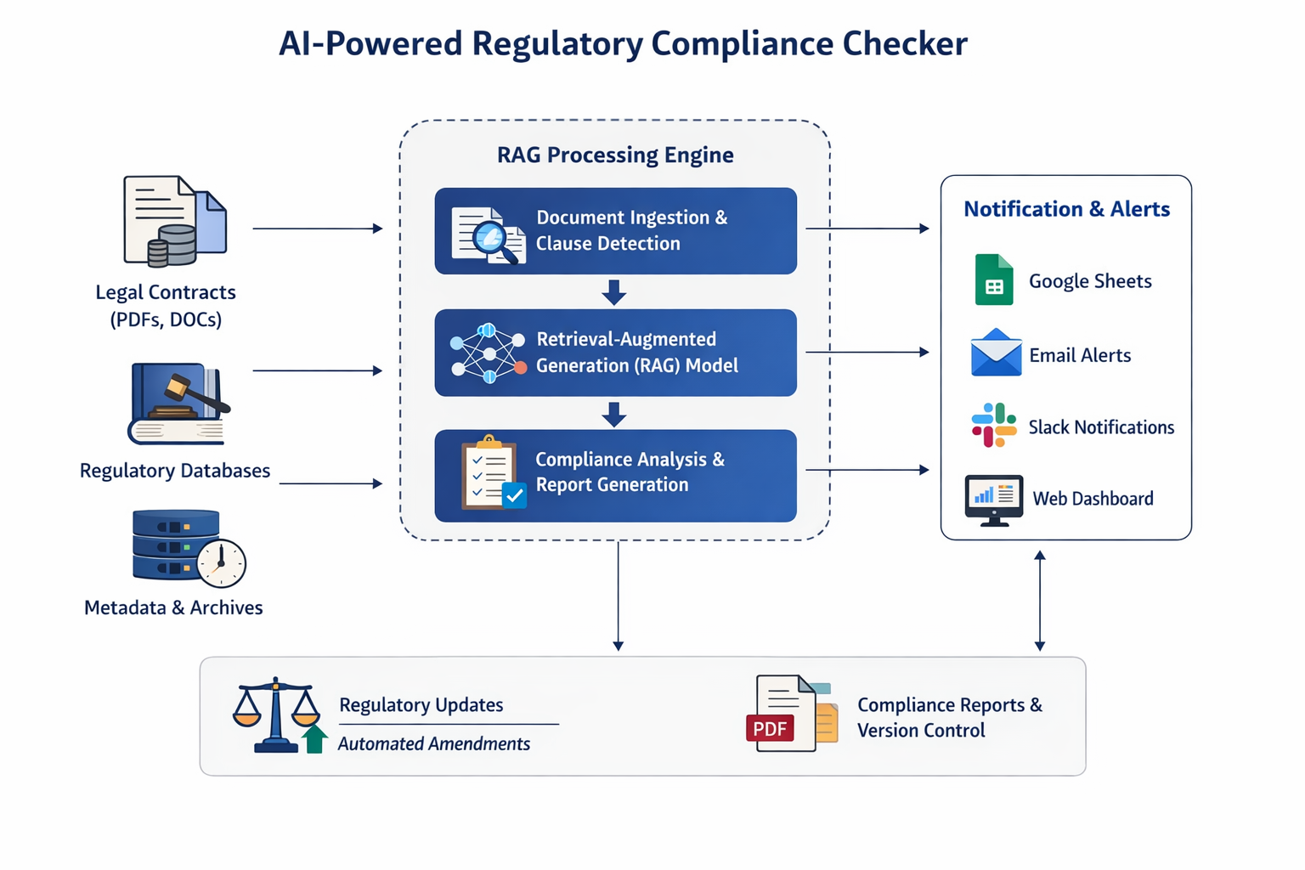

Slide 8
The LLM performs contextual analysis to generate:
Contract summary
Key clauses
Identified compliance issues
Suggested amendments
A Compliance Engine applies business logic to detect missing/ risky clauses.
Notification services (Slack, Email, Google Sheets) deliver real-time alerts for
compliance status.
Simple Overview:
Contracts → Processing → Embeddings → FAISS → Retrieval→ LLM (Groq) → Compliance Engine → Output / Alerts

Slide 9
TECHNOLOGY STACK:
The technology stack combines Python as the primary programming language with powerful AI and NLP libraries to build a seamless compliance checker. At the core is the LangChain framework, which orchestrates the RAG pipeline — processing contract text, generating semantic embeddings, and storing them in a FAISS vector database for fast retrieval. When a compliance query is made, the system retrieves relevant chunks and uses Groq’s LLaMA-3.3 model to generate context-aware analysis. Auxiliary technologies like PyPDF2 and ReportLab handle document parsing and PDF generation, while APIs such as Slack, Gmail (SMTP), and Google Sheets enable real-time notifications and reporting.

Slide 10
Programming Languages
Python (Core backend, processing, integration)
Core Libraries & Frameworks
LangChain – Orchestrates RAG pipeline
FAISS – Vector database for semantic similarity search
Sentence-Transformers – Embedding model (all-MiniLM-L6-v2) for converting text into numerical vectors
PyPDF2 – PDF text extraction
ReportLab – PDF generation
gspread + Google OAuth – Google Sheets integration

Slide 11
AI / LLM Models
Groq LLaMA-3.3-70b-versatile – Gen AI model for analysis
Hugging Face Embeddings – Lightweight embedding engine
APIs & Services
Groq API (LLM
Slack Webhooks (notifications)
SMTP/Gmail (email alerts)
Google Sheets API (real-time updates)
Public web scraping for regulatory data

Slide 12
Tools / Infrastructure
Git / GitHub — Version control
VS Code / PyCharm — Code editor
Python Virtual Environment — Dependency management
Local JSON database — Metadata store

Slide 13
FEATURES:
Automated Contract Compliance Analysis
Semantic Search & Retrieval
AI-Driven Insights with RAG + LLM
Version Tracking & Change Detection
Real-Time Notifications
Amendment Suggestions & Application

Slide 14
FUTURE IMPROVEMENTS:
Automated Regulatory Updates
Integrate live regulatory feeds from official sources.
User Dashboard & Visualization
Build a web UI for interactive reports and contract exploration.
Performance Optimization
Add caching and parallel processing for faster responses.
Active Learning Feedback Loop
Let users validate AI suggestions to improve model quality.
Cloud Deployment & Scalability
Dockerize and host system with role-based access and monitoring.

Slide 15
CONCLUSION:
Developed an AI-powered system for automated contract compliance analysis.
Leveraged RAG (Retrieval-Augmented Generation) to combine semantic search with generative AI.
Enabled context-aware compliance insights, including summaries, key clauses, and risk detection.
Integrated real-time notifications via Slack, email, and Google Sheets.
Built a scalable and modular pipeline with embeddings, vector search, and compliance logic.
System reduces manual effort, enhances accuracy, and improves regulatory adherence.

Slide 16
THANK YOU

